Slide 1
Project 3 – Growth of EV/HV Cars and Charging Stations
Group 1: Vijay, Sameer, Hail
19th March 24

Slide 2
The Story: - Electric and Hybrid vehicle (EV/ HV) usage is on the rise across the world - This story looks at sales data of EV and HV data across US - It also maps charging stations across US to see where they are concentrated - Data analytics and charging station concentration arms commercial and public decision makers to direct resources optimally - Public policy can then be directed in a certain direction - Commercial decisions can be made optimally based on current and potential sales opportunities

Slide 3
Data source Kaggel: - title={Electric &amp; Alternative Fuel Charging Stations 2023}, url={https://www.kaggle.com/ds/2375714}, DOI={10.34740/KAGGLE/DS/2375714}, publisher={Kaggle}, - title={Electric Vehicle Population}, url={https://www.kaggle.com/dsv/6687350}, Visualisations created using JavaScript / Pandas Data stored and extracted from PostgreSQL Datasets over 200,000 records merged using Pandas User driven interaction provided with API routes and Java dropdowns Final visualisation includes following views 1. Bar/ line/ pie charts 2. Heatmap 3. User interaction to explore data for specific region
How does the project address specific project requirements?

Slide 4
There are 5 views displayed
A user interface that allows user to locate a charging station based on EV/HV population
Pie chart showing proportion of public vs private charging stations
Bar chart showing EV/HV sales over the years by car brand and the top 10 car brands.
Line graph showing sales of EV/HV from 1993 to 2023. Pie chart that compares EV/HV sales.
Heat map highlighting density of charging stations across US
Java Visualisation / Pandas

Slide 5
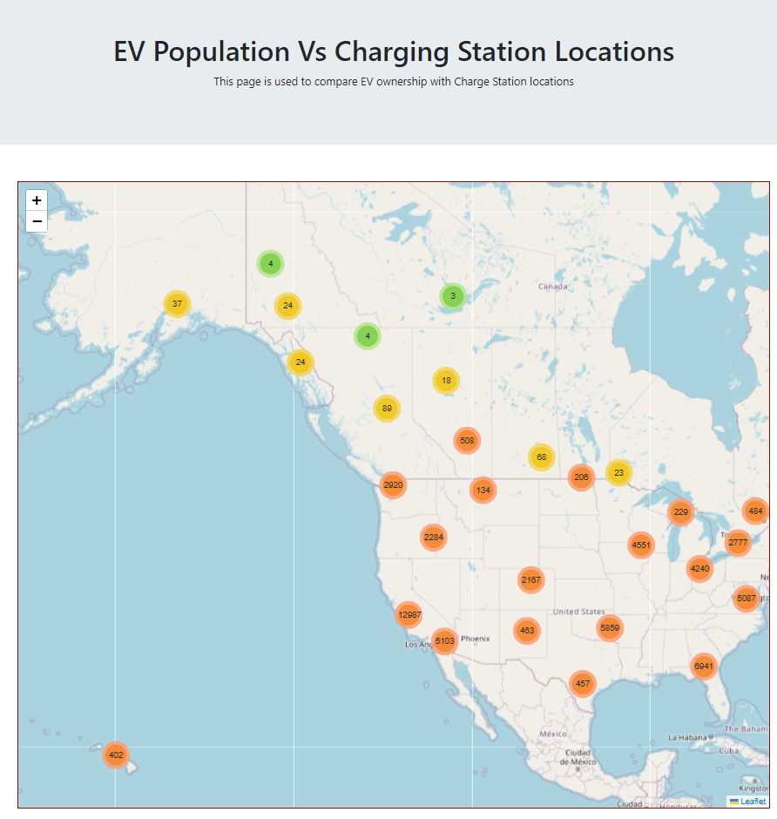
Java Visualisation : Population of EV/HV are shown where the charging stations are located
Each region is a charging station and shows how many EV/HV cars are in the area.
The user can click on a region and zone into the location of the charging station

Slide 6
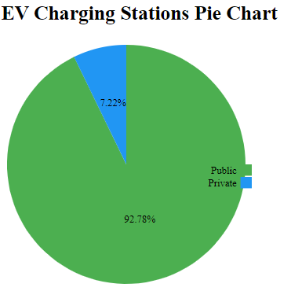
Java Visualisation : Pie chart showing number of public vs private charging stations
Public charging stations dominate the landscape

Slide 7
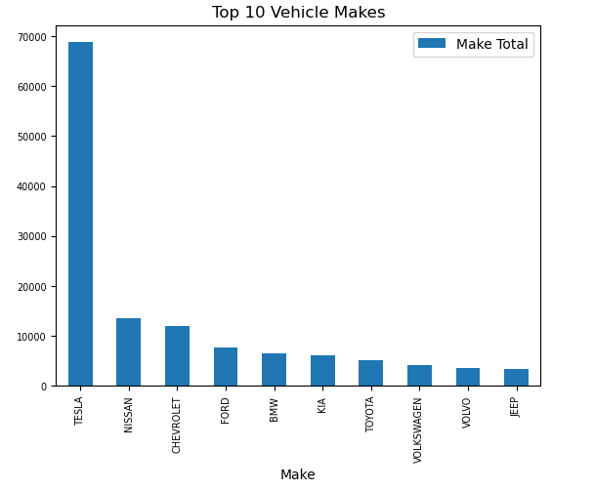
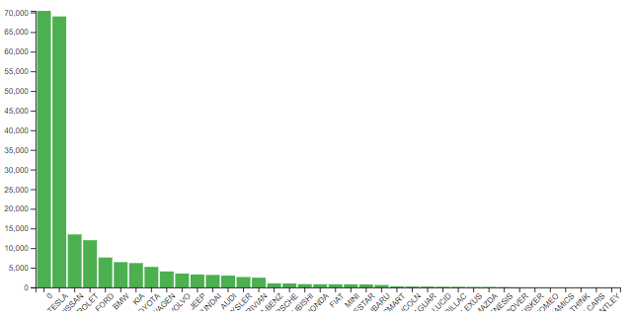
Java Visualisation / Pandas : Bar chart of sales of different EV/HV car brands
Tesla dominates the market followed by Nissan and Chevrolet

Slide 8
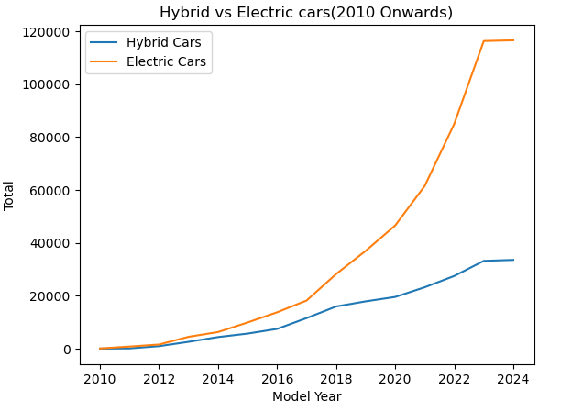
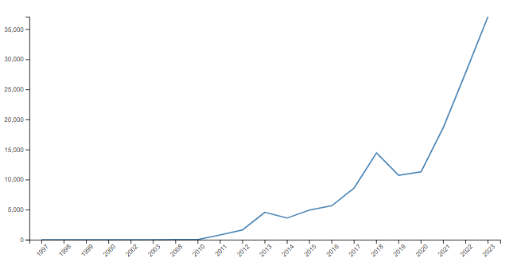
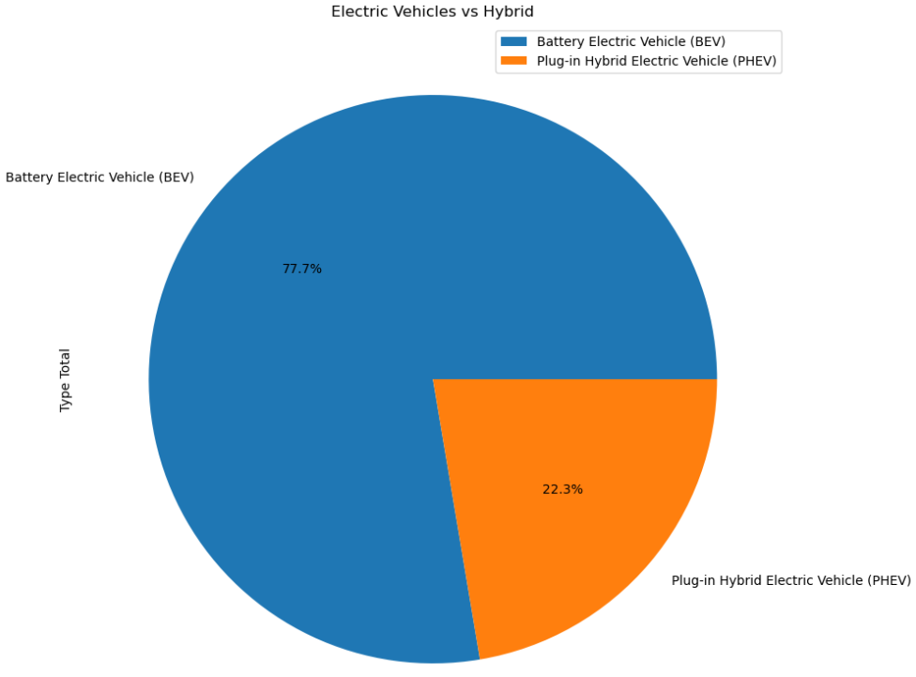
Java Visualisation : Line graph showing number of EV/HV vehicle sales from 1997 to 2023
Pandas Visualisation: Line Graph of rolling totals of EV/HV from 2010 to 2023
Pandas Visualisation: Pie Graph of EV vs HV
In 10years from 2013 to 2023 EV/HV sales have grown by 600%
Electric Cars heavily control the market, showing exponential growth compared to linear growth from hybrid cars.

Slide 9
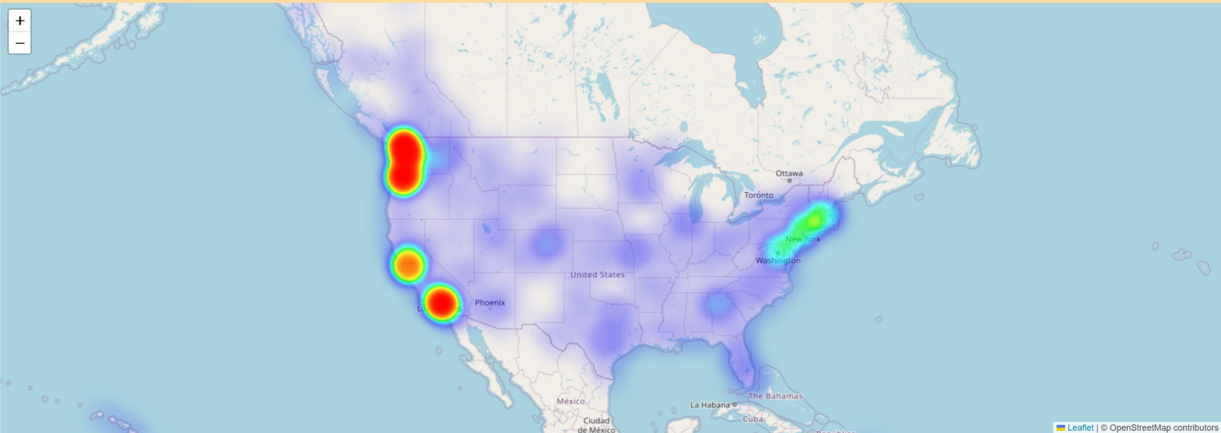
Java Visualisation 4: Density of charging stations across US
High density in western coastal cities
With inland density low
North Eastern coastal cities density is medium

Slide 10
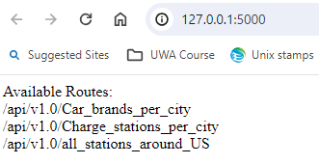
3 available routes are generated as below
API_Flask

Slide 11
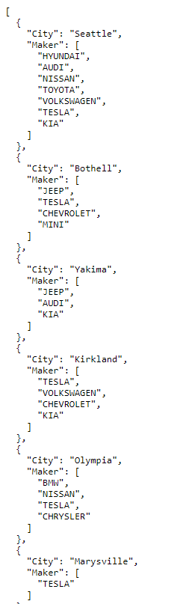
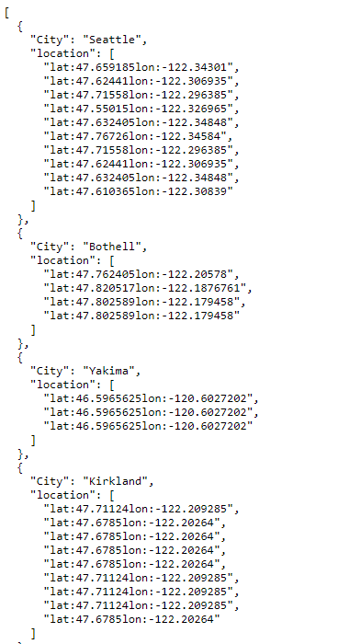
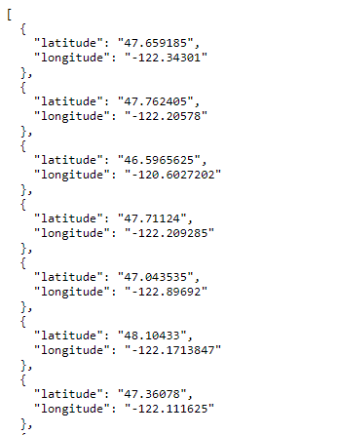
API_FLASK: Car brands per city/ charging station locations by city/ locations of all stations across US

Slide 12
Please follow below steps to run html files
Due to Cross-Origin Resource Sharing (CORS), html files are to be run on local server
Open a local server in the directory of the html file as below
Clear your browser cache to ensure you're not seeing cached content
Go to Windows Settings/ Storage and delete Temporary files
Type http://localhost:8000 to view Java visualisation
Notes to access data

Slide 13
Analysis of Data
EV/HV are on a significant growth curve, reasons for year on year fluctuations are not charted
Over 90% of public charging stations may be correlated to increased uptake of EV/HV vehicles
Heat map shows a correlation between densely populated areas and number of charging stations
Implications
Public policy can be framed for regions with similar population but varying degree of EV/HV uptake
This can be achieved by opening more charging stations in the area
Business wishing to expand too can open car dealerships based on sales data to get market penetration in these areas
Analysis and Implications

Slide 14
Data spread: Only for US
Data period: From 2010 to 2023
Though correlations are established, causality is not explored
Data Set was taken partway through 2023, so data from that year doesn’t reflect a full year's worth of data.
Limitations

